Slide 1

160 مليون
Notes:
150 مليون
اكثر من 150 مليون اجتماع شهريا يذهب من دون فائدة

Slide 2
المشكلة
Notes:
قد صار عندك اجتماع وطلعت منه وانت متشتت وناسي اغلب اللي سمعته؟

Slide 3
الـمـشـكـلـة
إنخفاض فعالية الإجتماعات
صعوبة تحديد المهام بعد الإجتماع
صعوبة تلخيص الإجتماعات
Notes:
هذا جزء من من مشكلة نبي نحلها
المشكلة كبيرة لكن جبنا لكم اكبر المشاكل
انخفاض فعالية الإجتماعات
صعوبة تحديد المهام بعد الاجتماع
صعوبة تلخيص الاجتماعات
ولان هذا الشي نتعرض له بشكل يومي في العملف قررنا العمل على حل هذه المشكلة

Slide 4
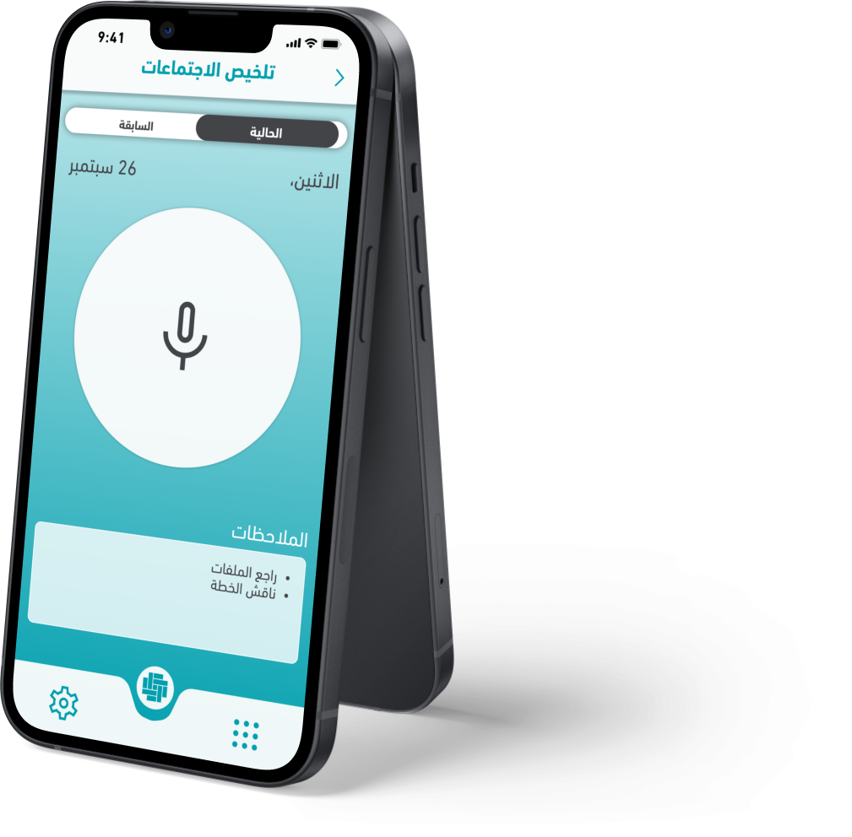

Notes:
عون
هو مساعد شخصي في عملك
يسهل لك وينقي لك
ال

Slide 5
ماذا يقدم عون
Meeting summarization
Define meeting tasks
Measure meeting performance
Email summrization
Search on meeting
Gather requirements

Slide 6
ماذا يقدم عون
Meeting summarization
Define meeting tasks
Measure meeting performance
Email summrization
Search on meeting
Gather requirements

Slide 7

Product demo

Slide 8
Product demo
Summary:
This is a final discussion for a hackathon that will be evaluated by 12 committees with 3-4 experts in each room. The 250 teams will be evaluated based on five criteria: local problem, feasibility, innovation, sustainability, and presentation. Each criteria has weak, acceptable, good, excellent, and distinguished evaluations. The winning projects will be evaluated by eight judges from different fields. The presentation should focus on the problem, solution, and plan B. The budget should be distributed wisely and should focus on sustainability. The presentation should be well-prepared and presented by the whole team.

Slide 9
Product demo
Important information:
- Criteria for evaluation: local problem, feasibility, innovation, sustainability, and presentation
- Each criteria has weak, acceptable, good, excellent, and distinguished evaluations
- Winning projects will be evaluated by eight judges from different fields
- The budget should be distributed wisely and should focus on sustainability
- Each presentation should focus on the problem, solution, and plan B
- The presentation should be well-prepared and presented by the whole team

Slide 10
Product demo
Tasks:
- Divide the team presentation into the problem, solution, and plan B
- Allocate the budget wisely and focus on sustainability
- Practice and be well-prepared for the presentation
- Ensure the presentation is presented by the whole team

Slide 11
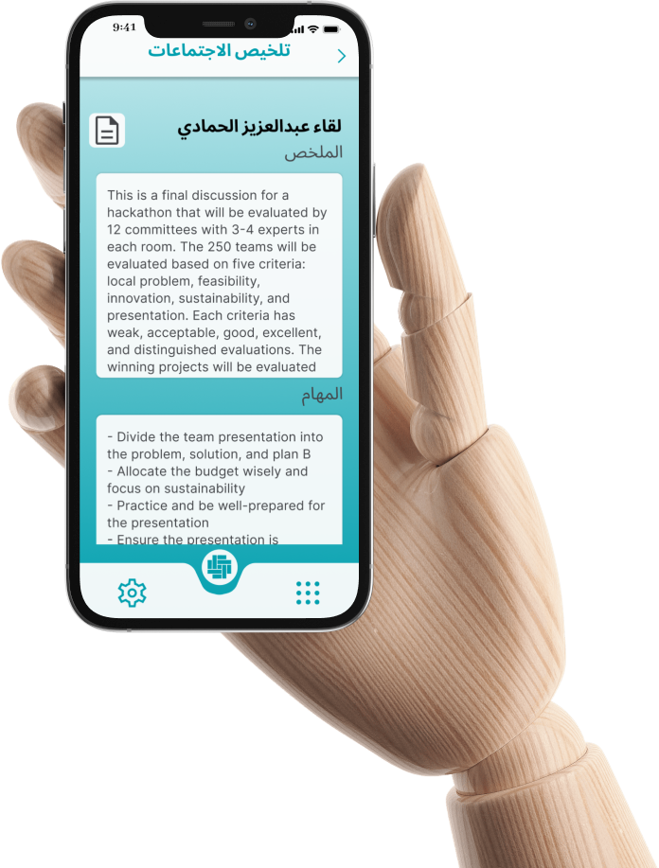
Product demo

Slide 12
كيف يعمل تلخيص الإجتماع
Whisper AI
ومنسق ذاتي
تحويل الصوت الى نص
تحديد الأصوات
تلخيص النص
عن طريق استخدام
Speaker Diarization
ChatGPT

Slide 13
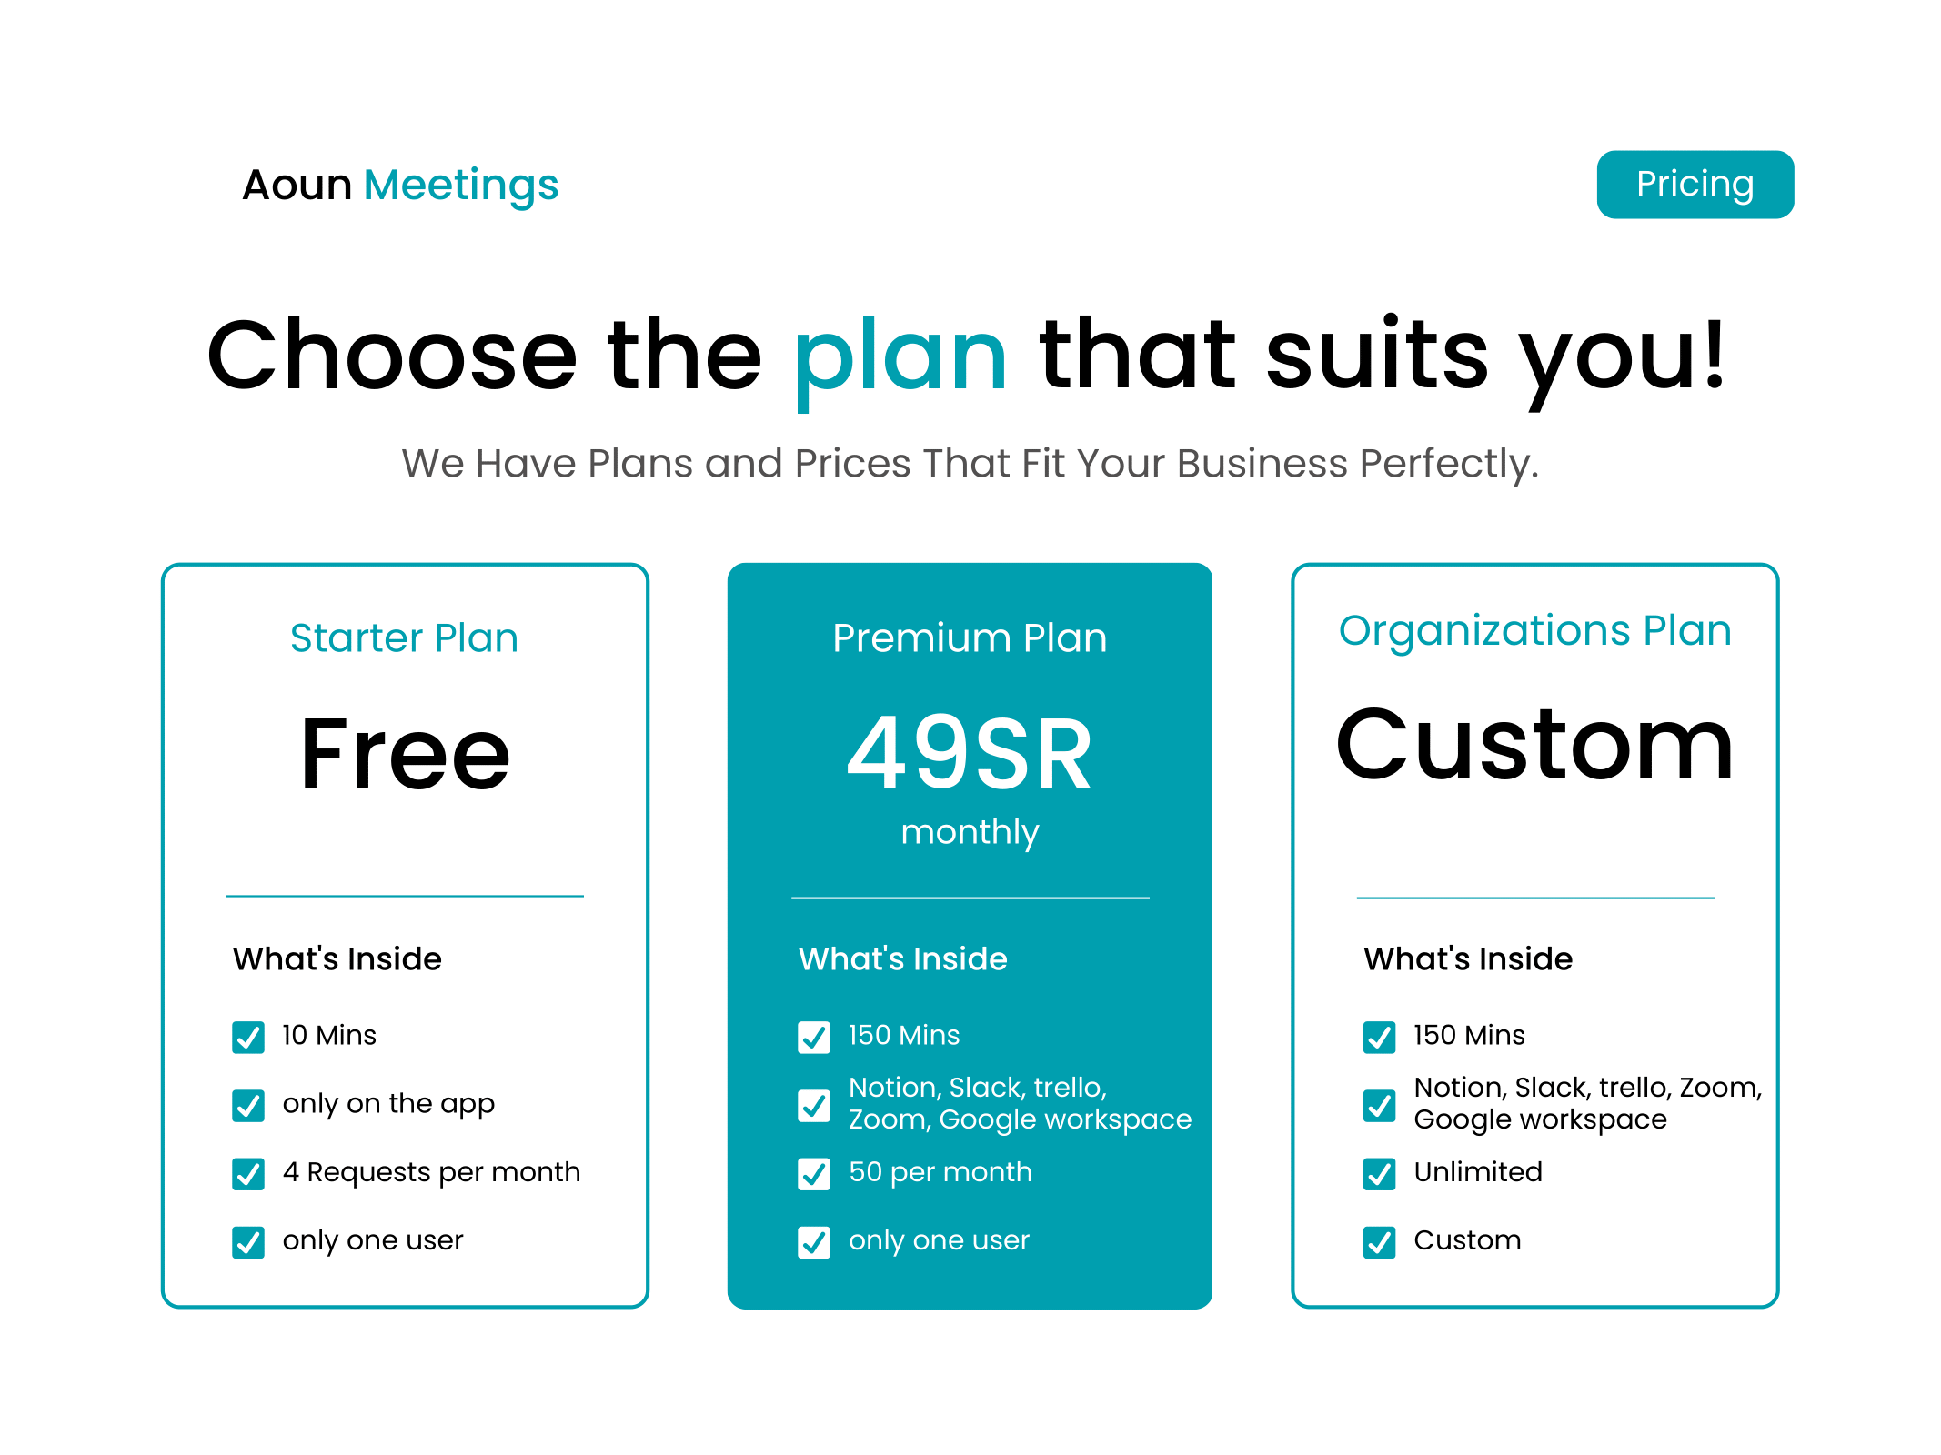
نموذج العمل
Year | Venus | Mars
2010 | $0.30 | $31.90
2012 | $3.90 | $15.40
2015 | $157.30 | $492.80
2019 | $3,368.20 | $13,929.80

Slide 14
افكار مستقبلية
Live context verifier
Generate Documents
Document summarization
Define Dates through meeting
Recognize Employees voices
Cumulative meetings

Slide 15
One more thing…

Slide 16
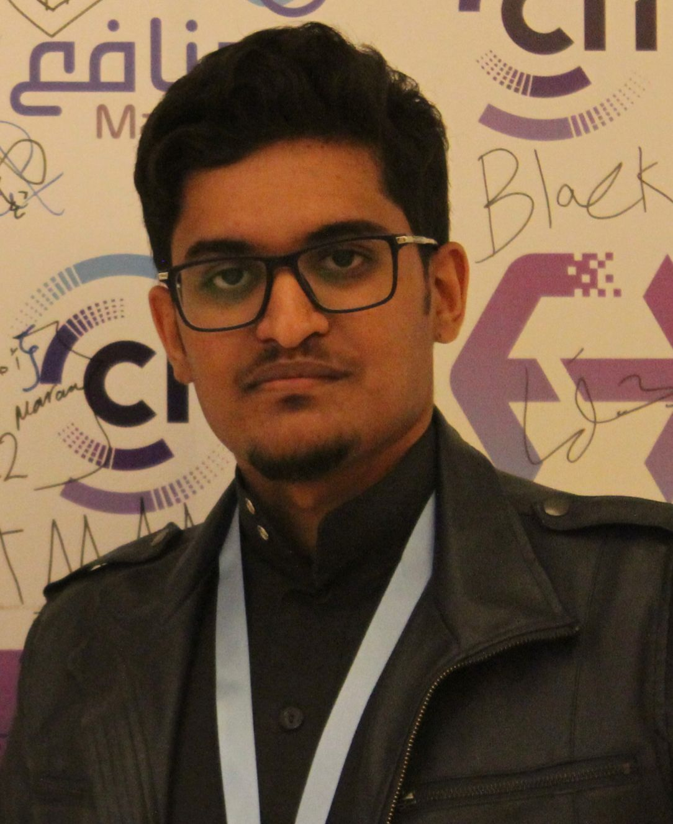


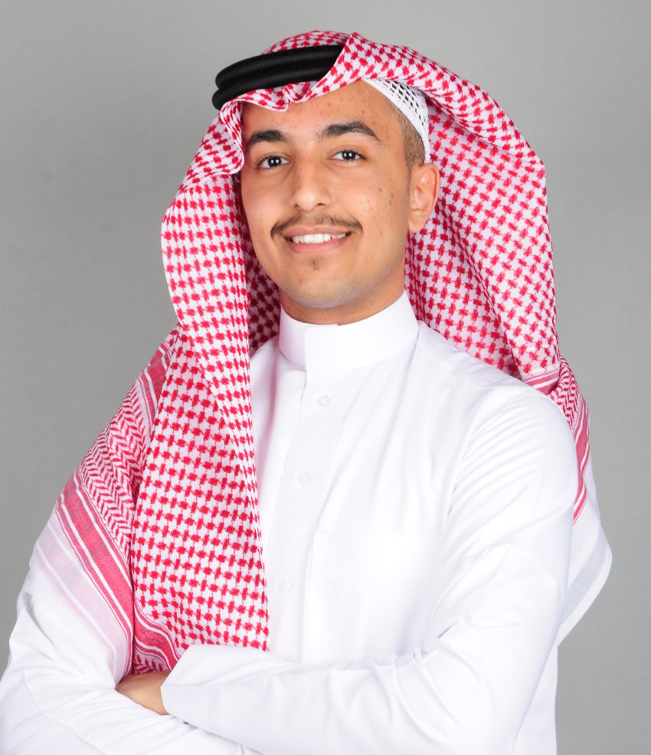

شكرا!

